Slide 1
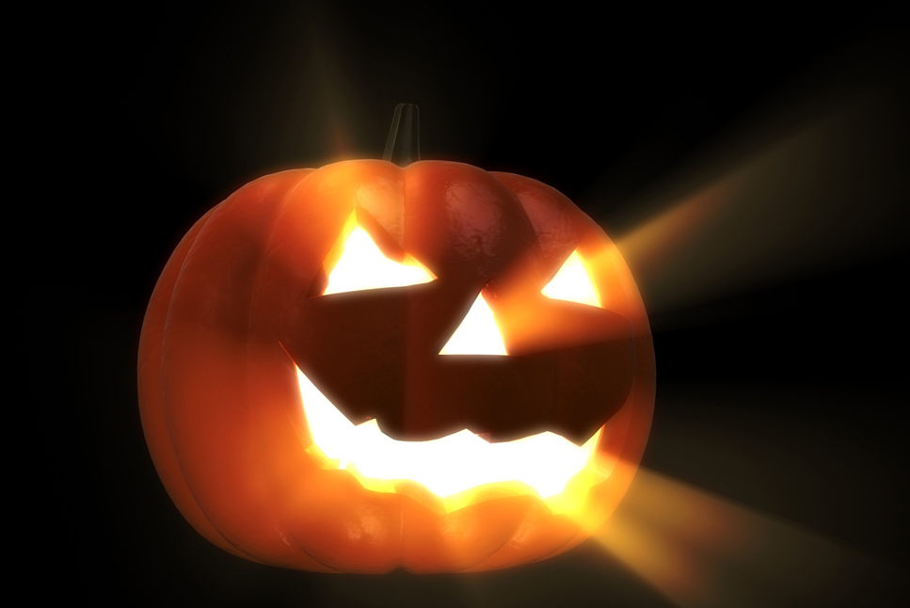
Halloween
Jeopardy

Slide 2
Halloween
The History | Similar Holidays | Traditions | Symbols of Halloween | Miscellaneous
1 Piece | 1 Piece | 1 Piece | 1 Piece | 1 Piece
2 Pieces | 2 Pieces | 2 Pieces | 2 Pieces | 2 Pieces
3 Pieces | 3 Pieces | 3 Pieces | 3 Pieces | 3 Pieces
4 Pieces | 4 Pieces | 4 Pieces | 4 Pieces | 4 Pieces
5 Pieces | 5 Pieces | 5 Pieces | 5 Pieces | 5 Pieces

Slide 3
Question:
This is the group of people whom Halloween is traced back to
Answer
The Celts
Back

Slide 4
Question:
The word “Halloween” derives from this Catholic Church Holiday
Answer
All Hallows Eve
Back

Slide 5
Question:
When the Celts celebrate their new year on October 31st, they believed the atmosphere was extremely thin and so these roamed the earth
Answer
Spirits
Back

Slide 6
Question:
Halloween came to America with the immigrants from this country
Answer
Ireland
Back

Slide 7
Question:
This was the name of the Celtic God who was celebrated on October 31st. It marked the end of summer and beginning of winter
Answer
Samhain (sow-in)
Back

Slide 8
Question:
All Saints’ Day is celebrated on November 1st by this religious group to honor the dead instead of fearing them.
Answer
Christians
Back

Slide 9
Question:
The belief that some people who die are stuck in purgatory is the main focus of this holiday.
Answer
All Soul’s Day
Back

Slide 10
Question:
On November 1st In Mexico, this holiday celebrates those who have died by decorating the grave site have having a feast
Answer
Day of the Dead
Back

Slide 11
Question:
Tomb Sweeping Day, celebrated in April, is a tradition to honor the dead by cleaning and decorating their graves in this country
Answer
Asia
Back

Slide 12
Question:
The British celebrate this holiday in honor of a man who was hung for trying to blow up parliament
Answer
Guy Fawkes Day
Back

Slide 13
Question:
This tradition originated in England, when people begged for food – or else -
Answer
Trick-or-Treating
Back

Slide 14
Question:
Used by the Celts to frighten ghosts and sprits away; they were fueled by dead animals and crops
Answer
Bonfires
Back

Slide 15
Question:
Villagers in Great Britain baked these for friendly spirits, in exchange for bad sprits leaving, and for the beggars.
Answer
Soul cakes
Back

Slide 16
Question:
Dressing up on Halloween originated with the Celts who wore these to scare off spirits or blend in with them
Answer
Dead animal skins and heads
Back

Slide 17
Question:
This magical element of Halloween was practiced by many different cultures and is how many of the apple games became popular.
Answer
Fortune Telling
Back

Slide 18
Question:
This animal is associated with Halloween because the Celts believed they were really Witches in disguise
Answer
Black Cats
Back

Slide 19
Question:
Although we now use pumpkins, this was hallowed out by the Irish and lit with candles to turn away spirits
Answer
Turnips
Back

Slide 20
Question:
He is said to have roamed all of Ireland with a lantern searching for a place to rest.
Answer
Jack
Back

Slide 21
Question:
Believed to have gathered on the night of October 31st; feared and hated by many
Answer
Witches
Back

Slide 22
Question:
The association of apples with Halloween comes from the Romans who honored this Goddess of Fruit on October 31
Answer
Pomona
Back

Slide 23
Question:
The association of pumpkins with Halloween originated in this country because they grew in such abundance
Answer
America
Back

Slide 24
Question:
Black and orange are the symbolic colors of Halloween because orange was associated with harvest and black with this
Answer
Death
Back

Slide 25
Question:
Halloween can be traced to as far as this many years ago.
Answer
3,000
Back

Slide 26
Question:
On Guy Fawkes day, these are asked for instead of candy
Answer
Pennies
Back

Slide 27
Question:
Halloween has grown into the 2nd most popular holiday in American thanks to marketing strategies. It brings in 2 billion dollars on candy alone. This is said to be the most popular trick-or-treat candy
Answer
Snickers
Back

